Slide 1
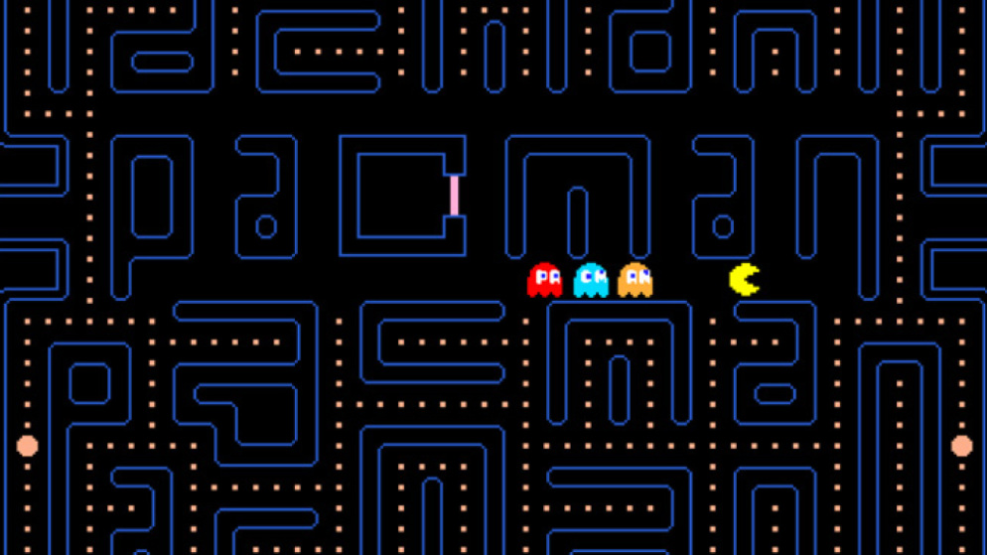
PACMAN
MAJOR OOP CONCEPTS AND/OR ALGORITHMS

Slide 2

SIMPLE AND FAST MULTI-MEDIA LIBRARY
SFML IS A MULTIMEDIA LIBRARY FOR C++
IT HAS BINDINGS AVAILABLE FOR OTHER LANGUAGES
ALLOWS DIFFERENT TYPES OF MEDIA LIKE 2D GRAPHICS, AUDIO, TEXT ETC
DYNAMICALLY LINKED LIBRARY

Slide 3
FPS STANDS FOR FRAMEWORK PER SECOND
USED TO CONTROL THE SPEED OF THE GAME CHARACTERS

Slide 4

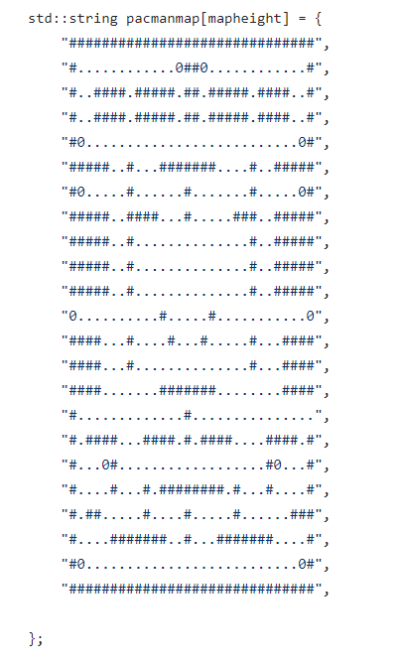
MAP
MAP IS HARDCODED
THE # REPRESENTS THE WALL
*DRAWN USING SFML
THE . AND 0 (10 POINTS) REPRESENTS PACMAN FOODS WITH GREATER POWERS RESPECTIVELY
* DRAWN USING SFML

Slide 5
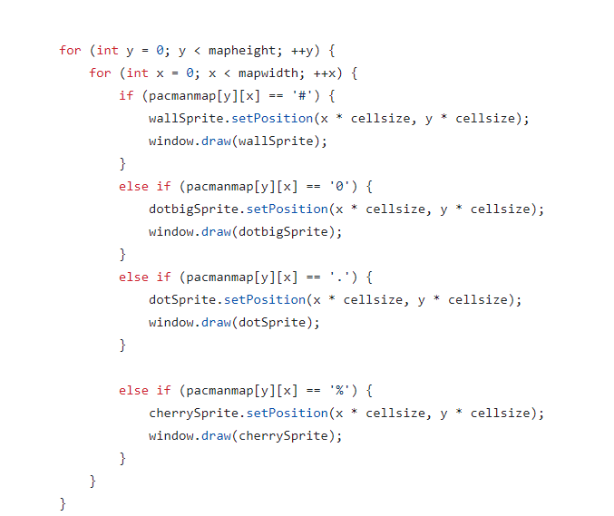
THIS LOOP IS USED TO SEE WHERE TO DRAW WHAT ACCORDING TO THE HARDCODED MAP

Slide 6
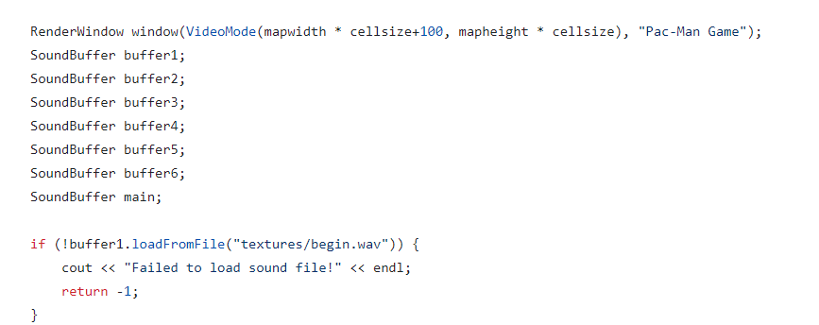
INSERTING THE SOUND FILES
CREATING SOUND BUFFERS AND VERIFYING IF BUFFER IS WORKING OR NOT

Slide 7
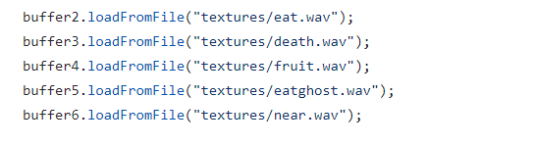
THE LoadFromFile IS USED TO LOAD THE SOUND FROM THE SFML FILE

Slide 8
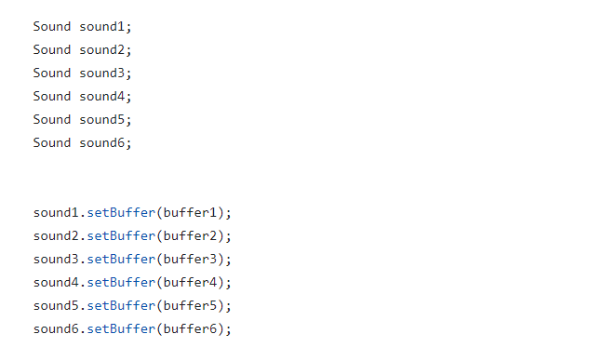
ADDED SOUND USING THE BUFFER PARAMETERS

Slide 9

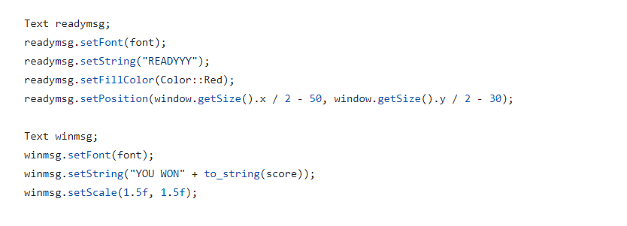
INSERTING THE TEXT FILES

Slide 10
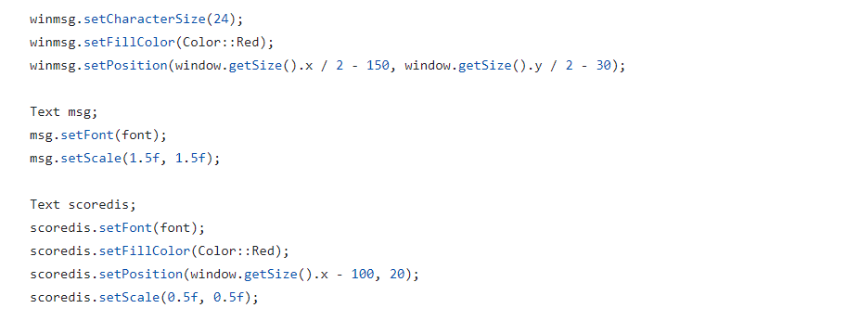
PRE-DOWNLOADED FONTS ARE SET USING loadFromFile AND THEN USED IN THE FILE USING THE FONT VARIABLE

Slide 11

LOADING BAR
THE POSITION IS GIVEN USING THE PRE-SET SYNTAX AVAILABLE IN C++
USING VECTOR WE HAVE GIVEN THE POSITION AND SET COLOR
WILL MAKE A RECTANGLE SHAPE AT RIGHT SIDE OF THE WINDOWS DUE TO THE POSITION GIVEN

Slide 12
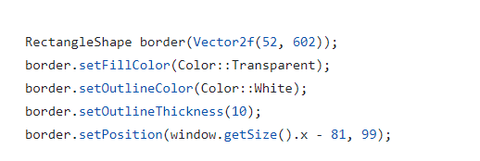
BORDER OF THE LOADING BAR
AGAIN USE THE SAME PRE-DEFINED SYNTAX

Slide 13
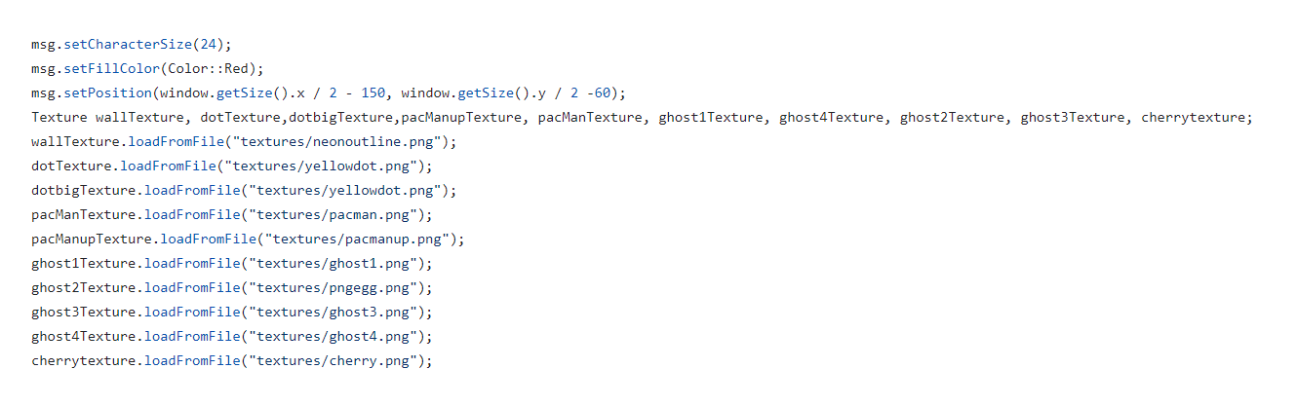
CREATING SPRITES
ALL PNGS ARE ADDED TO THE CODE

Slide 14
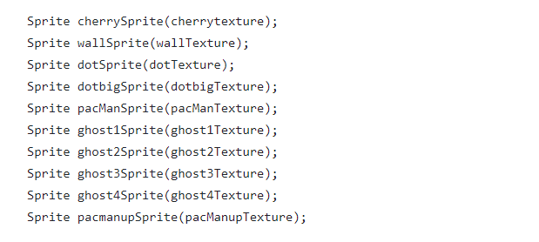
A SPRITE IS CREATED FOR EACH PNG USING THE TEXTURE FILE DECLARED PREVIOUSLY AS PARAMETERS
DISPLAYS PNG IN THE SMFL FILE

Slide 15
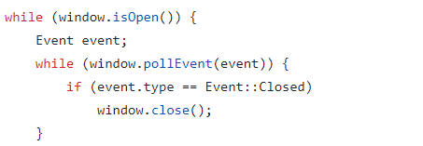
WORKING WITH SFML
LOOP TO MAKE THE SFML FIE WORK

Slide 16
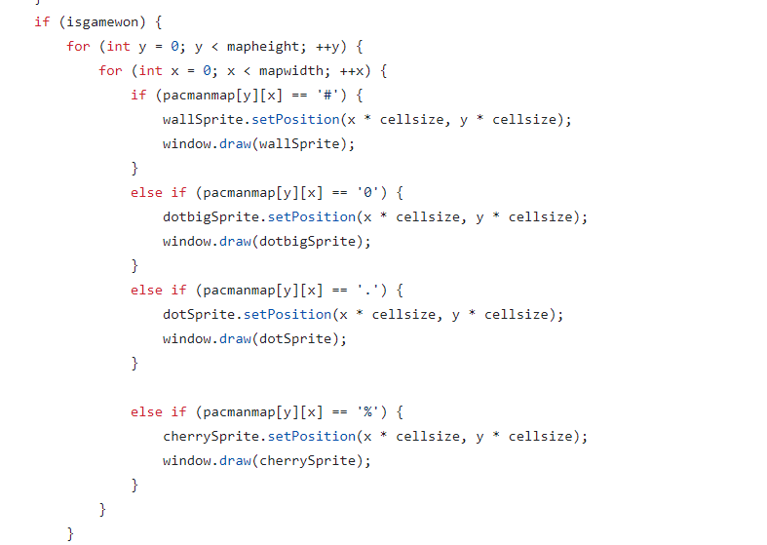
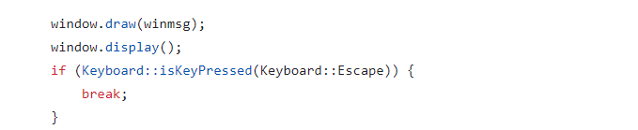
INSIDE THE LOOP A CONDITIONAL STATEMENT STATES THAT IF GAME IS WON THEN THE GAME WILL BE RESET TO THE INITIAL POSITION DISPLAYING THE MSG U WIN
DISPLAYS THE MSG U WIN

Slide 17
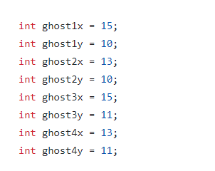
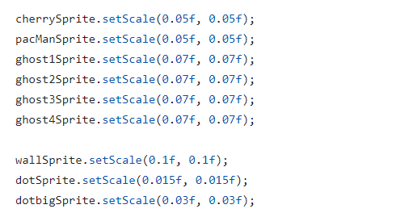
SETTING GHOSTS POSITION
4 GHOSTS CREATED AND ALL ARE GIVEN A POSITION WRT X AND Y
SET POSITION FOR GHOSTS AND CHERRY, WALL , DOT ETC

Slide 18

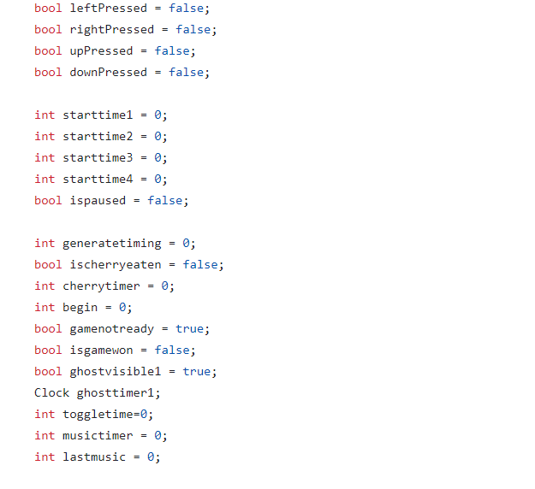
SETTING PACMANS POSITION
THE PACMANS X AND Y POSITION IS DECLARED
BOOLS AND TIMERS SET AS FALSE AND 0 FOR MOTION IN THE GAME

Slide 19
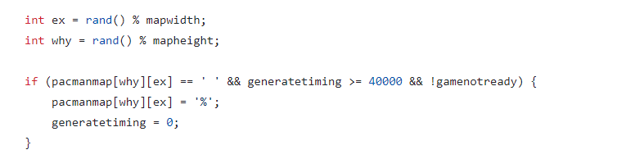
WORKING WITH THE CHERRY
A RANDOM X AND Y POSITION IS TAKEN IF GENERATE TIMER IS GREATER THAN 4000 AND THE PLACE IS EMPTY AND A CHERRY IS DISPLAYED IN PLACE OF %
IF CHERRY IS EATEN WITHIN LESS THAN 10,000 THEN IF ANY OF THE GHOST REACHES PACMAN THEN PACMAN CAN EAT IT AND THE GHOST WILL RETURN TO ITS ORIGINAL POSITION

Slide 20
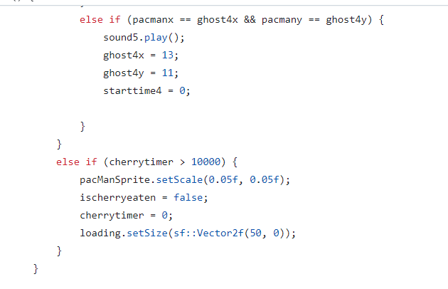
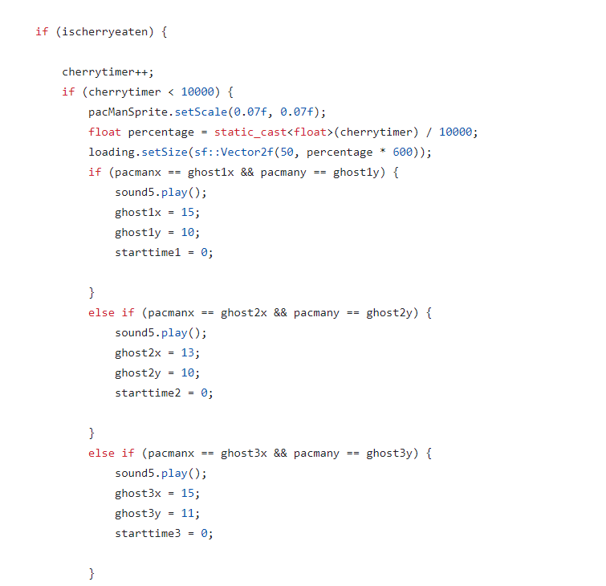

Slide 21
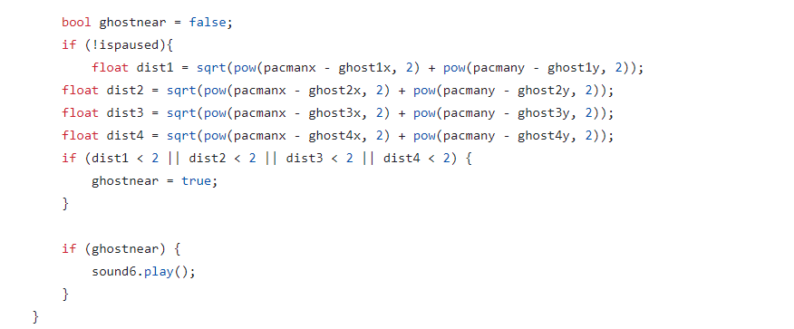
GHOSTS MOVEMENT
THE GHOSTS POSITION IS SUBTRACTED FROM THE PACMANS POSITION TO MAKE SURE THAT THE PACMAN IS ALWAYS CHASED BY THE GHOST WITH A SPECIFIC MUSIC PLAYED

Slide 22
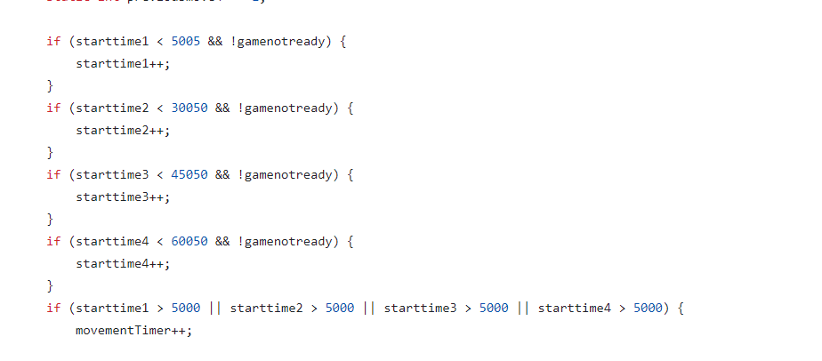
DECLARED STARTING TIME FOR GHOSTS COMING ONE AFTER ANOTHER

Slide 23
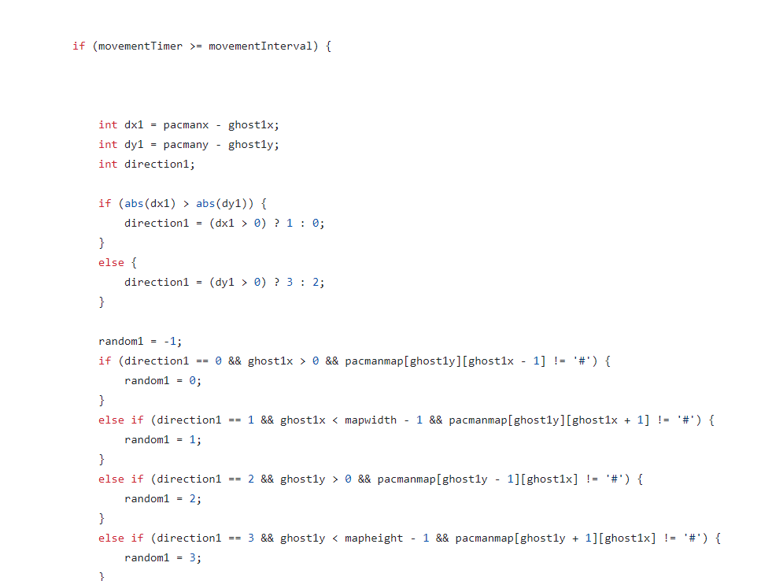

Slide 24
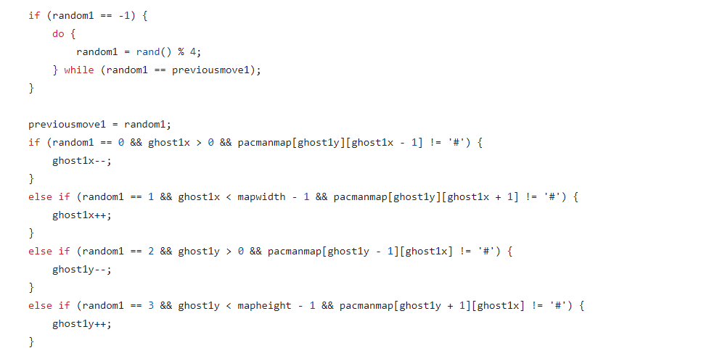
SAME LOGIC USED FOR ALL GHOSTS

Slide 25
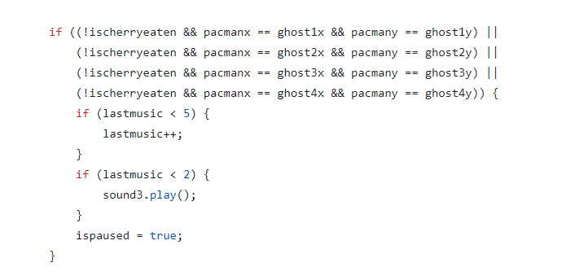
PAC MAN IS EATEN BY THE GHOST
IF GHOST EATS THE PACMAN AND CHERRY HASN'T BEEN EATEN THEN PAC MAN WILL DIE AND A SOUND WILL BE PLAYED AND ISPAUSED WILL BE TRUE

Slide 26
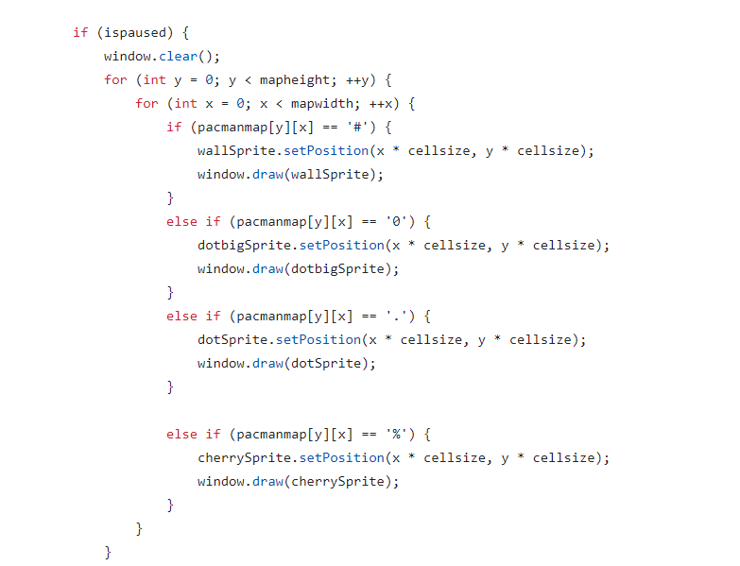

Slide 27
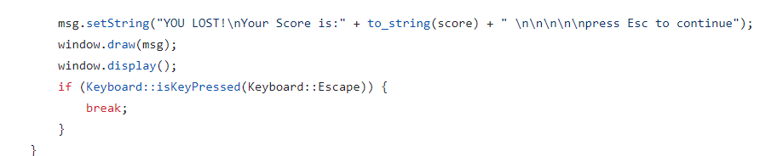
SINCE THE IS PAUSED IS NOW TRUE THEN THE SPRITES WILL GO BACK TO ORIGINAL POSITIONS AND THE YOU LOST MSG WILL BE DISPLAYED

Slide 28
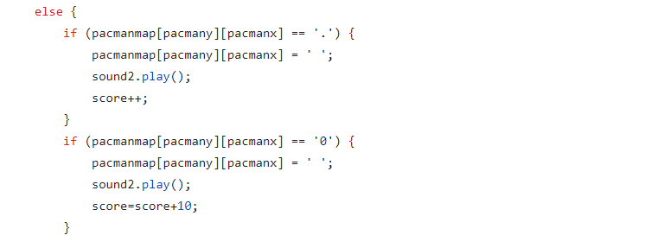
SCORING
SOUND IS PLAYED AND SCORE IS INCREASED ACCORDING TO THE FOOD EATEN

Slide 29
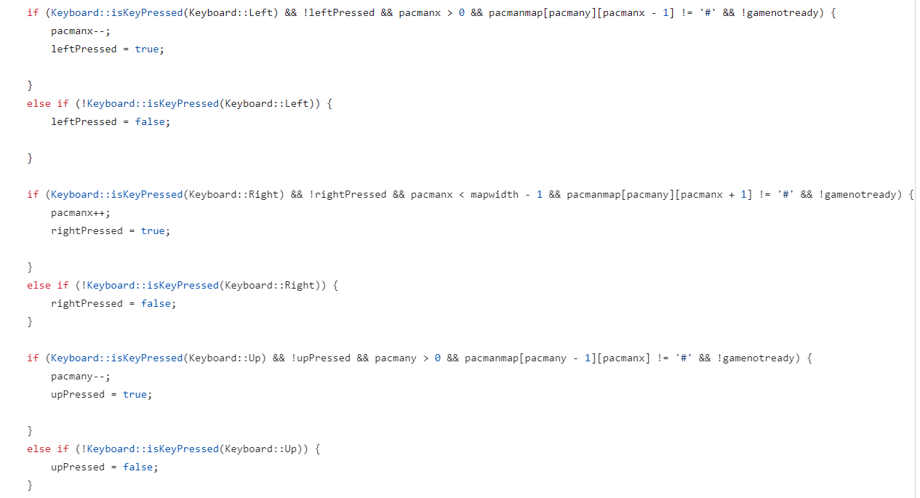
PACMANS MOVEMENT
IF KEY PRESSED IS LEFT THEN THE PACMANS INITIAL POSITION IS SUBTRACTED TO MOVE LEFT AND SO ON FOR OTHER POSITIONS

Slide 30
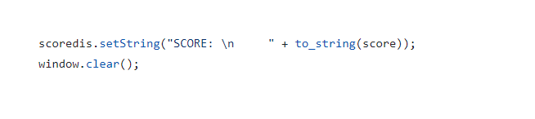
DISPLAYING SCORES WHILE THE GAME IS ON
USED TO CONTINUOUSLY DISPLAY SCORES

Slide 31
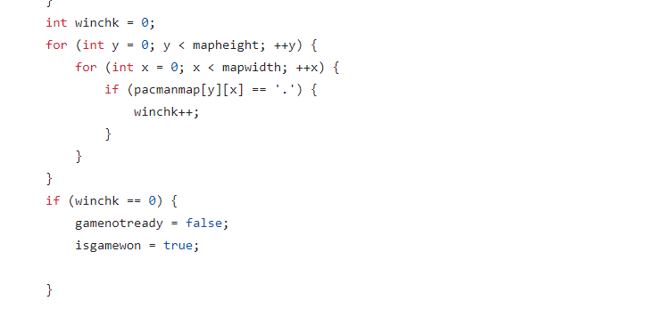
WINNING THE GAME
THE MAP IS CHECKED TO SEE IF THERE IS ANY FOOD LEFT ON THE MAP IF NOT THEN PACMAN WINS

Slide 32
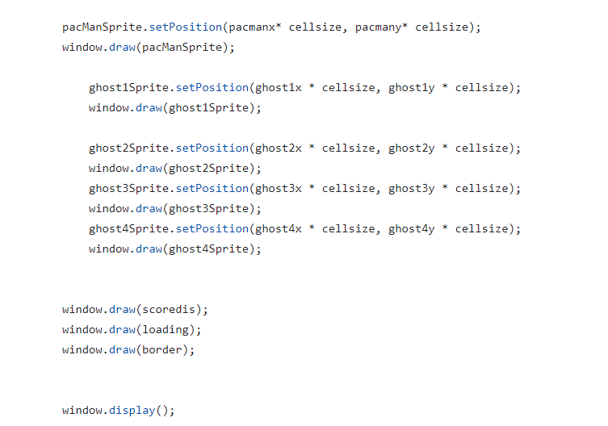
GAME ENDED
THE ENDING POSITIONS ARE SHOWN AND ALSO THE SCORE BOARD, LOADING BAR, AND BORDER ARE DRAWN

Slide 33
THANKYOU!
Prepared by:
Zunaira Amjad 23k-0013
Murtaza Jaffri 23k-0076
Hamza Sheikh 23k-0060

